Slide 1
Notes:
Ask is listeners have used a service to deliver food

Slide 2
Gig Economy
A new way to work
Elias Leonhardsberger
19.01.2024
ENG1UE_BB_Gr.1
FH Hagenberg

Slide 3
Definition
No employees
Only “contractors”
Often direct customer worker communication
=> Company only brings them together
https://www.investopedia.com/terms/g/gig-economy.asp

Slide 4
Advantages
Flexibility
Cheaper for companies
Less overhead => cheaper products, more pay
https://www.investopedia.com/terms/g/gig-economy.asp
https://www.weforum.org/agenda/2021/05/what-gig-economy-workers/
https://www.mckinsey.com/featured-insights/mckinsey-explainers/what-is-the-gig-economy

Slide 5
Disadvantages
Less job security
Often no healthcare for workers
Limited worker protections
Limited customer protections
https://www.investopedia.com/terms/g/gig-economy.asp
https://www.weforum.org/agenda/2021/05/what-gig-economy-workers/
https://www.mckinsey.com/featured-insights/mckinsey-explainers/what-is-the-gig-economy

Slide 6
Types of work
Food delivery
Transportation
Graphic design
Programming
House-sharing
https://www.weforum.org/agenda/2021/05/what-gig-economy-workers/

Slide 7
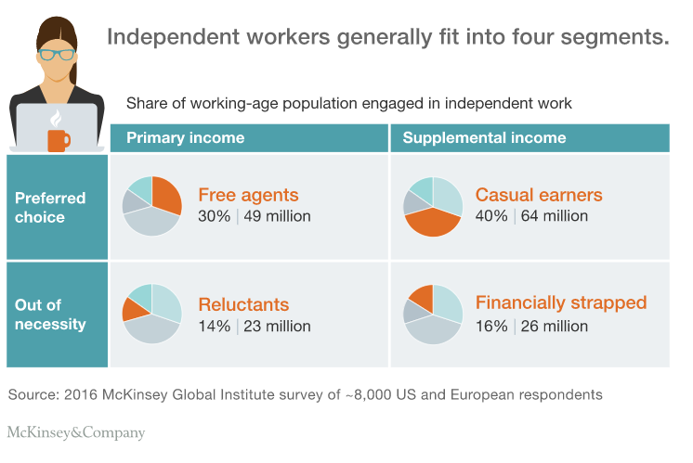
Types of workers
https://www.weforum.org/agenda/2021/05/what-gig-economy-workers/

Slide 8
Conclusion
Biggest profiteer => companies
High risk, high reward for customers and workers
Workers have higher risk
https://www.investopedia.com/terms/g/gig-economy.asp

Slide 9
Sources
https://www.investopedia.com/terms/g/gig-economy.asp
https://www.weforum.org/agenda/2021/05/what-gig-economy-workers/
https://www.mckinsey.com/featured-insights/mckinsey-explainers/what-is-the-gig-economy

